Slide 1
BRIDGE-IT JANE’S FLYING SEMINARS
MEMBER EXPERIENCE

Slide 2
GIVE MEMBERS A GOOD EXPERIENCE
YOU GROW!!!

Slide 3
GIVE MEMBERS A POOR MEMBER EXPERIENCE
YOUR CLUB WILL DECLINE AND CLOSE

Slide 4
IDEAS NATIONWIDE
Looking from the outside in
From embryos to our most senior of senior citizens

Slide 5
DON’T LEAVE IT TOO LATE!!
Clubs with a declining membership of 100 plus should not be complacent
Clubs with a declining membership of 40 – 100 members – hardest to change
Clubs with 9 to 40 –easiest to change and help

Slide 6
CHANGING MEMBER EXPERIENCE
If your club is declining and you keep doing what you are doing it will continue to decline.
Look around your clubrooms next visit
If your club is declining and you want to survive, you need to change what you are doing.
Change can be hard for some.
Change is necessary to survive.

Slide 7
LESSONS
Typical cycle
Bridge-It Jane’s cycle

Slide 8
RETENTION OF BEGINNERS
PLAN AHEAD
CAREFULLY MANAGE 3 MONTHS POST LESSONS
Go for a WOW factor!

Slide 9
PLAN AHEAD!
October – plan playing schedule
10 weeks lessons Term 2. (local needs)
2 weeks bid and play in school holidays.
Final bid and play start of Term 3 - Invite Buddies
Graduation evening – social wine/cheese?
2-3 weeks welcome pairs series with buddy
(separate section if big enough club)
5/6 week individual series (ALL HANDICAP)
3 weeks teams including dress-up
Ensure first event in New Year is a 3 week individual

Slide 10
BUDDIES
BUDDIES – LYNCHPIN TO SUCCESSFUL RETENTION
Their job – keep their beginner coming to club
Before programme book goes out – book buddies
Bridge ability worst qualification
Patient, kind, understanding best qualification
Buddies are not there to teach
Buddies are there to ensure beginner comfort
Buddies contact beginner when poor result

Slide 11
BUDDIES
Every beginner receives a programme book on graduation – print extras – first names
First time they play at club – start helping them to fill their programme diary – biggest aid to continuing
Buddy checking in regularly and before each new series to ensure partner found
Teacher/lesson administrator also double checks (in case buddies not doing their job) – get them booked in!!
Contact beginner and offer game in New Year

Slide 12
COMMON BARRIERS
Clubs allow existing members to get away with being rude to new members
Playing too many boards (16 when first come in – 22 max in a field containing novices)
Playing too late (give new members time to fall in love with the game before asking them to play beyond 10pm)
Not following through after an absence - diarising

Slide 13
SEPARATE SESSION
Much harder for small clubs (Huntly)
New session – their rules existing members have to comply
Practice session – replay hands from night they played at club
Small club – have to give over 3 months of each year to beginner type playing sessions to survive.

Slide 14
RETAINING BEGINNERS
Green pens – no fancy system/no penalty doubles
Improvers programme (1-3 years – sep night/before play)
Monthly newsletter to beginners (templates)
Buddy liaison – chivvying up buddies not doing their job
Mini Moos – novice events

Slide 15
EXISTING CLUB MEMBERS SETTING EXPECTATIONS!!
Include them in process – update in club announcements at playing session and emails
Warn existing members: Expect noise!!
Give no advice unless asked for by a beginner
Cribsheets in use until first championship event in new year.
Phone a friend
Safety phrase – TMI – Buddies and Members

Slide 16
EXISTING CLUB MEMBERS
Handicaps in place for first 3 months before adjustment. (But show both so existing members not left out – consider prize for raw in this period)
Play will be slow 10 pm cut off point
NO RUSH AND SHUSH!!!
Don’t call director – let them pick up cards/allow a revoke (world will not end!!)
Read Riot Act to members with OTS – stay away
Poems

Slide 17
MEMBER EXPERIENCE
Members are your most valuable asset
What do you give your members?
What is their membership experience?
How much money do you have in the bank?
GNH

Slide 18
WOW FACTORS
Members are most valuable asset at any club – VALUE THEM!!!
Blind date
Create best impression
Working bee/Decorations
Heat
Lighting
Refreshments
Websites

Slide 19
MONEY
Savings – what are you saving for?
No savings – grants
Competition for leisure time
Carpet – curtains – wobbly tables – assorted chairs
Cup of tea and a biscuit
Look modern, vibrant and alive!!

Slide 20
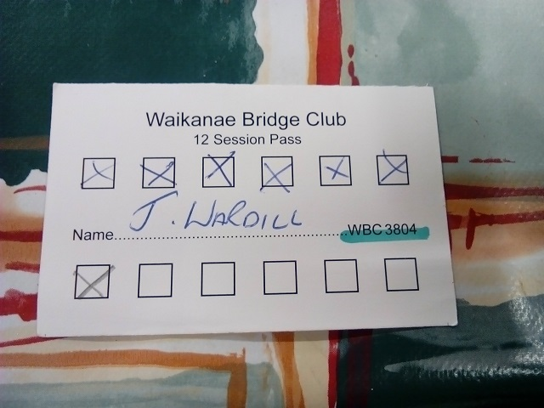
COFFEE CARDS

Slide 21
CELEBRATE – HAVE FUN!!
Celebrate age – over 80s – cake
Fish and chip suppers
Quiz evenings - fundraisers

Slide 22
CARE FOR YOUR MEMBERS
Almoner
Send an email of congratulations when win a series
Take photos to put on website
Know who has come top for the first time ever
See new players trying a senior session – encourage them – send email if they go badly
Start of each new series – partnership steward – online entries - send an email/text inviting them along
Last round – round of applause – appreciate director

Slide 23
BRIDGE-IT JANE PROJECTS
Nesting Pairs
Starting in March 2018
6 monthly seminars and practice sessions
YouTube seminars
Skype in Bridge-It Jane

Slide 24
THAT’S ALL THERE IS TO IT!!
Any Questions?
My email address is:
Jane.stearns@nzbridge.co.nz
Please contact me if you would like any help/ideas
Rejuvenation video https://www.youtube.com/watch?v=Vq--E8zfGyo
NZB – Resources - Marketing

Slide 25
THANK YOU ….
WAIKATO BAYS REGIONAL COMMITTEE
Good Luck to your Region and All your Clubs
Happy Bridging

Slide 26
THANK YOU – GOTTA FLY!!

